Slide 1
EMERGING TECHNOLOGIES, THE OPPORTUNITY FOR ACCOUNTANTS TO SHINE - insights from the academic literature
Ana Ferreira | Isabel Pedrosa
56th World Continuous Auditing and Reporting Symposium
Madrid, Spain
April 27 & 28, 2023
Notes:
Hello everyone, its a pleasure to be here, my name is Ana Ferreira, I am from Portugal, n accountant and a master's student in management information systems.
I’m going to present the emerging technologies, has the opportunity for accountants to shine

Slide 2
OVERVIEW
Motivation and Introduction
The Profession of Accountant
The Impact of the Emerging Technologies
The Future Skills and Role of the Accountant
Conclusions and future developments
Notes:
It is so important to review the literature on the evolution of accounting, the framework of the profession of accountant, identifying emerging technologies and understand the profile and skills of the accountant in the digital age.

Slide 3
01
Motivation and Introduction

Slide 4
Motivation and Introduction
As the world becomes increasingly digital and data analysis becomes more important, accountants need to become more up-to-date with the latest software and technology to remain competitive.
Emerging technologies are changing the accounting paradigm. “It has always been done this way” will certainly be an old expression that will become outdated.
While some experts predict an uncertain future for accountants in a digital world, technologies such as cloud-based data management, robotic process automation, and advanced analytics present opportunities for accountants
Notes:
Various studies predict that some professions will become obsolete or “die” in the next few years. In fact, in 2020, the COVID-19 pandemic accelerated the adoption of technology across industries, and accounting was no exception
It seeks to unveil the accounting discipline's new challenges that need technology so much .

Slide 5
Research Objectives and Contributions
The future is bright for accountants. With the advent of technology and the growing demand for financial expertise, accounting and finance professionals are in high demand.
The aim of this work is to make a contribution to the need for adaptation and resilience on the part of current and future accountants in the face of emerging technologies.
Notes:
The main goal of this study is to research the impact of emerging technologies on the work of the accountant and assess the necessary digital skills that Accountants need to develop, given the new paradigm in Accounting.
The purpose of this presentation, based on a literature review, is to reflect on challenges and responses from emerging technologies to support accounting.
It seeks to unveil the accounting discipline's new challenges that need technology so much .

Slide 6
02
The Profession of Accountant

Slide 7
The Profession of Accountant
The accounting of the past, surrounded by big and heavy books, papers, and even more papers, was a picture of passive and “analogic” accounting.
Accounting, written in the present and anticipated in the future, is done by active, business-oriented accountants using digital tools.
The accountant becomes a professional of excellence, with an innovative posture, more dedicated to tasks in which more work is required intellectual, analysis and appreciation of information with a strategic vision for the company/entity where it operates, and not so much routine tasks associated only to records of facts that occurred in the entity (Cristina et al., n.d.).
The accounting profession is changing from less emphasis on recording operations to more involvement in management support and decision-making (Almeida & Carvalho, n.d.).
“The multiplicity of tasks, very administrative and not very challenging, make the accountant's career not very interesting. In order to be a successful Chartered Accountant, it is necessary to minimize tasks that do not add value. Technology is extremely important in helping the business to offload paper-based and routine tasks, use and dematerialize IT mechanisms.“
Paula Franco, Chairwoman of the Portuguese Institute of Chartered Accountants
Notes:
The profession of accountant is of great responsibility, it is perhaps one of the most demanding professions from the point of view of knowledge and updating, however in Portugal it is not highly valued.
Due to the workload of meeting legal and tax deadlines, the accountant is often unable to stop to optimize repetitive tasks that prevent him from having time to analyse data and extract insights.
Technology has been increasingly used in accounting in Portugal, with the adoption of accounting management systems and process automation software. Artificial intelligence, blockchain and other emerging technologies are also starting to be explored in accounting in Portugal. However, the adoption of emerging technologies in accounting still faces some challenges, such as resistance to change by some professionals and the need to guarantee the security and confidentiality of accounting information.
A technological evolution has transformed our day-to-day life, simplifying our work, streamlining processes and automating procedures, and also requiring them to radical change in the exercise of its functions, as well as a quick ability to The sucess of the profession has been in its ability to partner effectively with new tecnhologies as they come in and to be able to really bring the human plus machine

Slide 8
The Impact of the Emerging Technologies
03

Slide 9
The Impact of the Emerging Technologies
Among the technological innovations driving change, highlight the disruptive potential of cloud accounting, Big Data and data analytics, artificial intelligence and machine learning, and blockchain, describing the accounting industry as one of the few that is constantly innovating and adapting (Kokina & Davenport, 2017)
Big Data and advanced analytics tools, cloud computing, and artificial intelligence as technologies offering new opportunities and solutions to enhance and adapt accountant’s ability to work through the complex and rapid journey of this digital age (Ibrahim et al., 2021)
Notes:
This paper presents the theoretical framework of literature review research to identify the emergence of disruptive technologies and the consequent impact on the accounting profession.

Slide 10
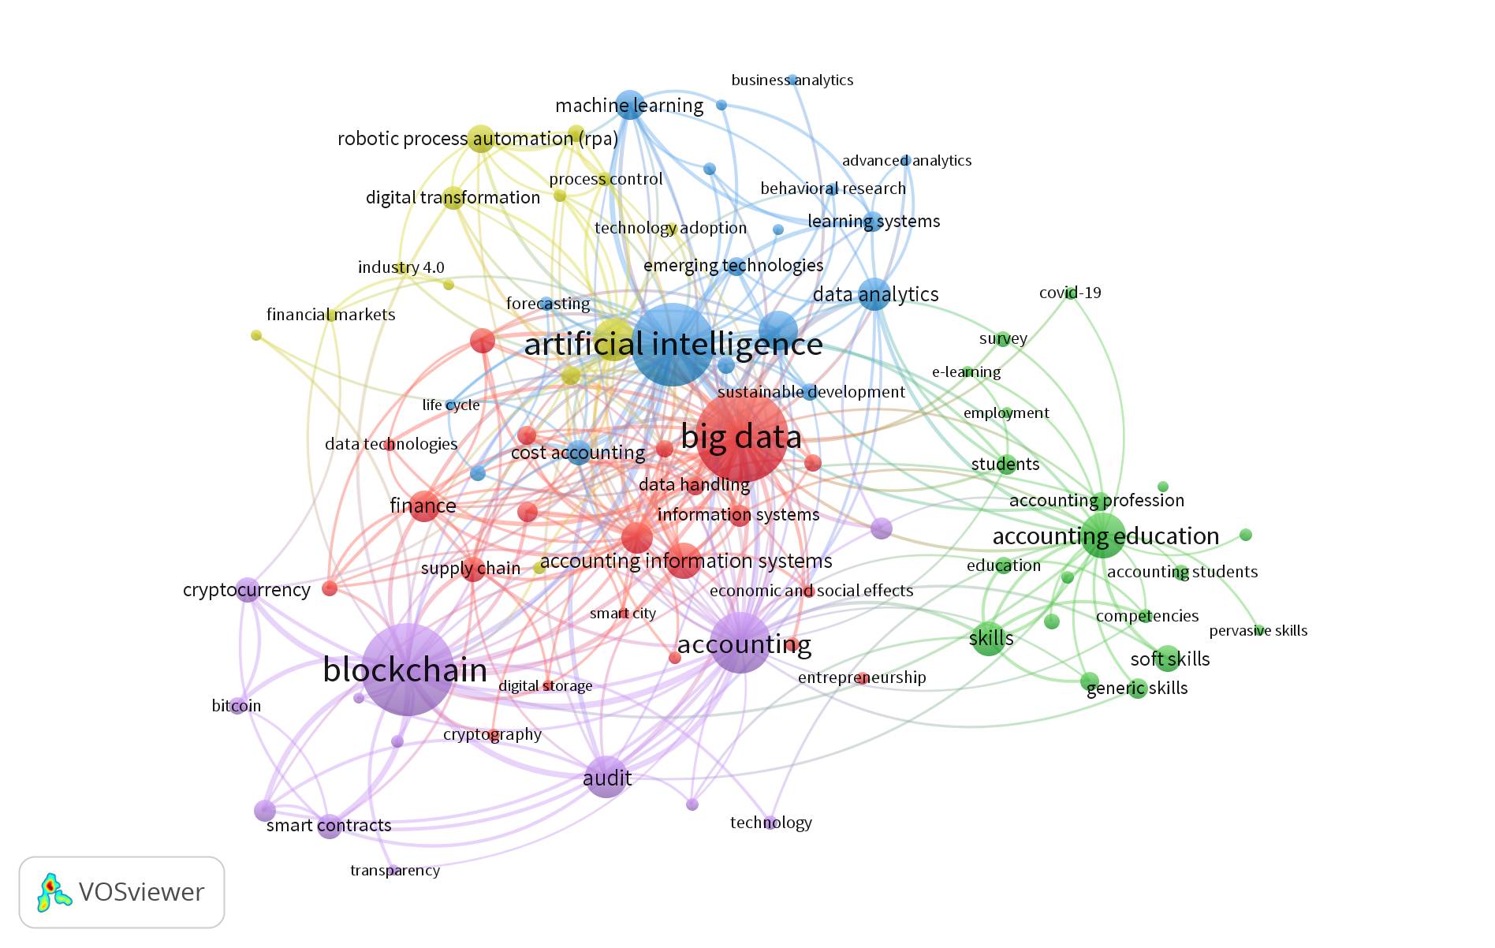
Bibliometric relationship of all keywords
( KEY ( big&data OR blockchain OR artificial&intelligence OR automation OR skills OR robotic&process&automation OR emerging&technology ) AND TITLE-ABS-KEY ( accounting OR accountant ) )
Notes:
The collection of articles related to the topic to be analysed was extracted in the Scopus database, which ensures the quality of the collected articles.
Filters related to the time period were applied, and only articles within the last 10 years were selected, that is ”> 2013”, restricting the results obtained to articles written in English and published only in areas as Business, Management and Accounting, Decision Sciences and Economics, Econometrics and Finance. This search returned 931 articles.
In order to obtain a bibliometric relationship of all keywords , we used the VOSviewer software, where we obtained the following maps. The keywords were harmonized using the thesaurus function in the VOSviewer.
5 clusters are illustrated: in green, related to “accounting education”; in purple, related to “blockchain”; in blue, related to “artificial intelligence”; in red, related to “Big Data”, and in yellow, related to “automation”.

Slide 11
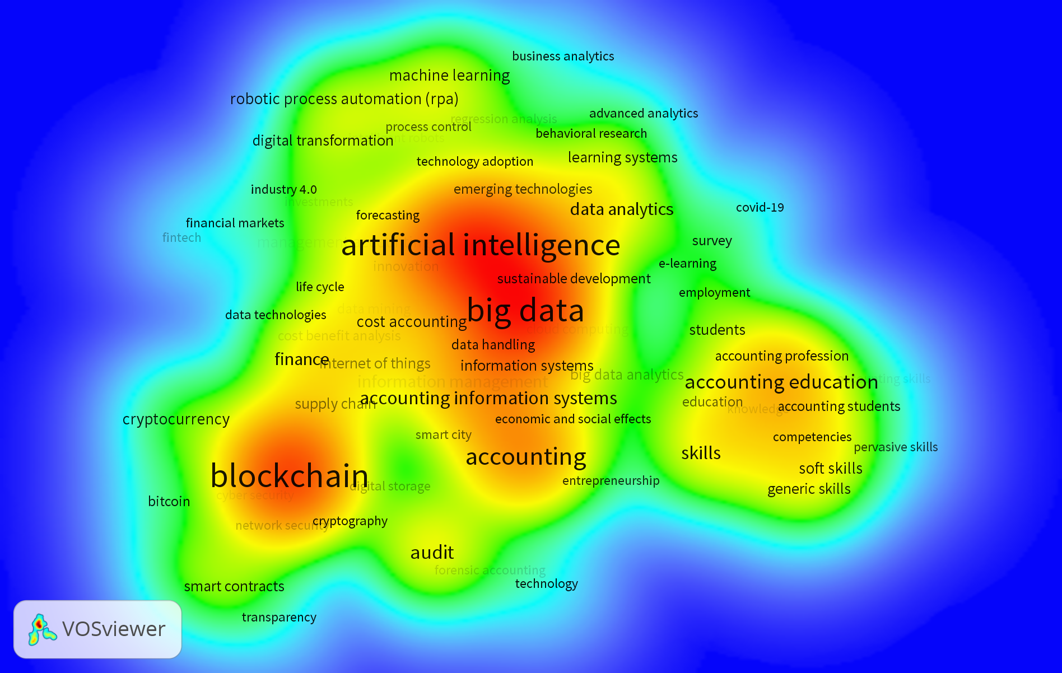
Density Visualization
Notes:
VOSviewer allows also to observe the density of the co-occurrences, which illustrated the importance of Big Data, Blockchain and Artificial Intelligence in the accounting field
From on-going research, based on analysis of VOSviewer results it is important to review concepts associated with the topic of accounting and emerging technologies.

Slide 12
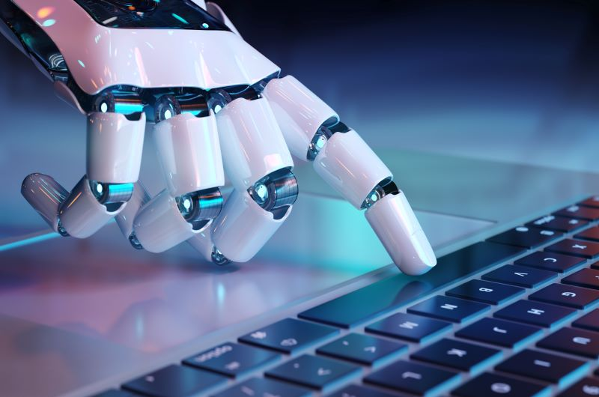
ARTIFICIAL INTELLIGENCE (AI)
Automation of repetitive tasks
Time-saver
Improved Accuracy and Efficiency
Decision Support
Predictive analytics
Fraud detection
Inputting and matching data
Receipt reconciliation
Creating and sending invoices
Expense reports
Tracking price changes
Account reconciliation
Sorting transactions
Data recording and reporting
Notes:
AI can be a huge time-saver for accountants and finance professionals. With the help of artificial intelligence, computers will take over tedious or repetitive tasks, so you don’t have to do them yourself! You can spend more quality hours providing actionable insight instead of crunching numbers all day.
In resume, some of the main impacts of artificial intelligence in accounting:
Automation of repetitive tasks
AI can automate repetitive and routine tasks, such as recording financial transactions and reconciling accounts. This can reduce the time accounting professionals spend on manual tasks, allowing them to focus on more strategic activities
Predictive analytics
AI can be used to analyze large sets of financial data and identify trends and patterns. This can help companies make more informed decisions and anticipate financial problems
Fraud detection
AI can be used to detect anomalies in financial data, helping to identify potential fraud or errors
Improved Accuracy and Efficiency
AI can help improve the accuracy of accounting records and reduce the time required to complete them, which can lead to greater efficiency and cost savings
Decision Support
AI can provide valuable information for accounting professionals, such as cash flow forecasts and profitability analysis. This can help them make more informed and strategic decisions for the company
The future of accounting is now in AI

Slide 13
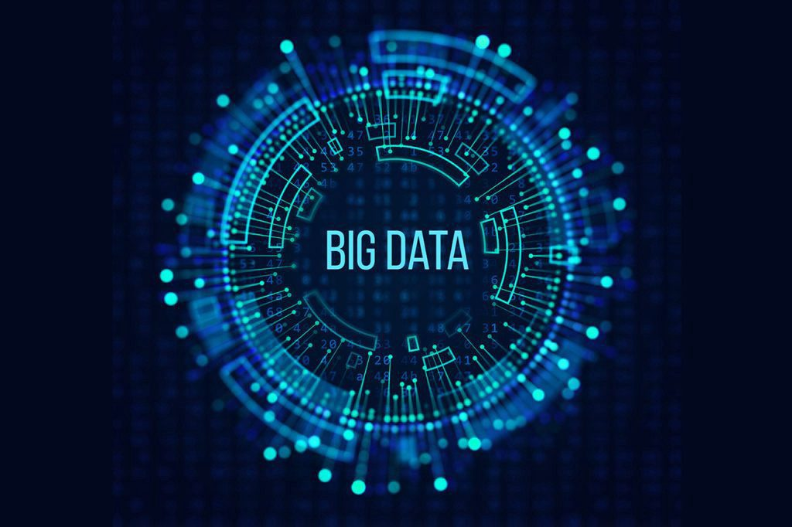
BIG DATA
Faster, more accurate data analysis
More transparency and compliance
Greater efficiency
Increased data security challenge
Predictive analytics
Can impact modern methods for valuation of intangible assets
Corporate reporting can change its approach and accelerate the shift to real-time reporting by emphasizing perspective elements of information content
Expansion and improvements in performance metrics used within the management control system
Financial statements could incorporate more decision-useful information for investors, based on exogenous data from sources such as social media and sales data
Notes:
Big Data has had a significant impact on accounting, providing a number of benefits and challenges for accountants. Here are some examples of how Big Data is impacting accounting:
Faster, more accurate data analysis
Accountants have access to massive amounts of data and can analyze it quickly. This allows for more accurate analysis and more informed decision making
Greater efficiency
Companies can automate many accounting processes, allowing greater efficiency in performing tasks such as account reconciliation and bank reconciliation.
Predictive analytics
Accountants can use predictive analytics to predict trends and identify potential problems before they occur, allowing companies to take preventive action
More transparency and compliance
Companies can improve financial transparency and compliance, making it easier for regulators, investors and other stakeholders to access a company's accounting information
Increased data security challenge
Companies need to be more aware of data security risks and implement adequate security measures to protect sensitive information

Slide 14
BLOCKCHAIN
Enable users to real-time accounting
Enable self-verification
The information available for analysing/supervise the function
Continuous monitoring
Improve efficiency and effectiveness of accounting practice
Increase accuracy and reliability
Enables information to be viewed, but not copied, changed or deleted. All transactions are encrypted
Accounting data is available at all times, which creates opportunities for more efficiently analyzing complex financial reports
Reconciliation process can be easier and an accurate record
Notes:
This section explains blockchain capabilities and potential that disrupt the management accountant’s role
Blockchain enables users to real-time accounting. This mean management accountants as users can access transaction and other data in real-time and on-demand
Blockchain system would improve internal control, risk mitigation, and prevent fraudulent transactions with its capability to maintain irreversible records.
Once a transaction record in the network, it is hard to manipulate or change the data. Blockchain can provide the user with this capability to reliable accounting information
Blockchain is the future of finance. It’s more than just an innovative technology. It has significant implications for accounting and financial professionals alike, such as enabling smart contracts that protect ownership rights or verifying people’s identities with credentials from one source (which saves time).
Once these features become mainstream over the coming years, they will open doors to new business opportunities like reducing costs by recording data accurately without middlemen who take their slice first, increasing traceability, so you know what products came off supplier shelves when inventory counts were low due to shopping attempts.
With Blockchain and distributed ledger technology, accountants will no longer have to enter their information into multiple databases. This could save them time, since they won’t need reconciliation procedures for each database anymore!
The reconciliation process can be a time-consuming and laborious manual task. The use of blockchain technology offers great benefits to make this tedious job easier by providing both parties with an accurate record, allowing them to trust in their respective transactions, leading towards efficient analysis.
The accounting data is available at all times, which creates opportunities for more efficiently analyzing complex financial reports.

Slide 15
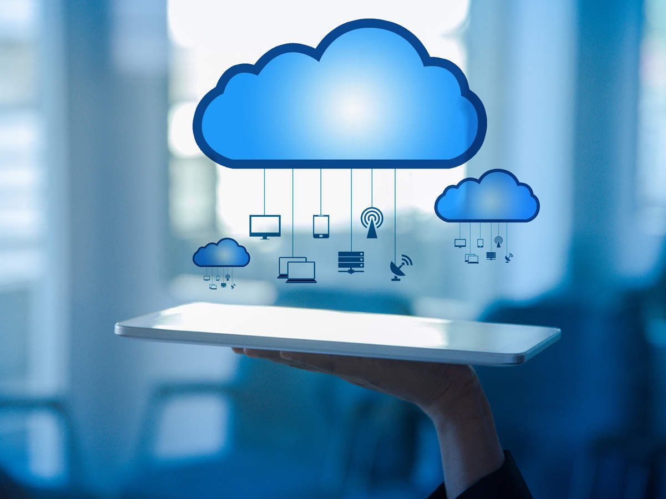
CLOUD-COMPUTING
Remote Access
Scalable storage
Security
Cost reduction
Paper-free
Collaboration
can access their data and applications from any device connected to the internet
send invoices electronically
more flexibility at the workplace
improved efficiency in accounting processes with less time spent in communicating accounting information with clients
Notes:
With obvious benefits in terms of cost reduction and work streamlining, the bet on digital cloud computing platforms is one of the pillars of what is called "collaborative accounting" the new form of relationship between accountants and companies, which aims to reduce barriers raised by physical distancing, facilitating the exchange of information and reducing operating costs for companies.
The role of cloud computing in the work of accountants is significant, as this technology offers several advantages, such as:
1. Remote Access: With cloud computing, accountants can access their data and applications from any device connected to the internet, allowing them to work from anywhere at any time.
2. Scalable storage: Cloud computing allows accountants to store large amounts of data without having to invest in additional hardware. This is especially useful for companies that have a large amount of data to store.
3. Security: Cloud service providers often offer advanced security features, including data encryption and constant monitoring, making cloud computing a secure option for storing and managing accounting data.
4. Cost reduction: Cloud computing eliminates the need to invest in expensive hardware and software, as well as reducing the need for infrastructure maintenance and upgrades.
Paper Free Paperwork is a thing of the past, as many modern-day tasks are completed digitally, quickly, and efficiently. Ask vendors to send invoices electronically so they can be imported directly into your Cloud Accounting system – all without sacrificing financial security or customer service excellence in any way whatsoever.
Collaboration is revolutionizing the finance industry. Gone are the days when employees needed to manage multiple versions of financial data or copies onto thumb drives for them all to collaborate on a single file. Now they can work together seamlessly from anywhere as long as you have internet access. Closing processes will happen much quicker and simplify other tasks like forecasting easily because there’s no more decentralized system.

Slide 16
AUTOMATION (RPA)
Increased Productivity
Save Time
Higher Compliance
Better Customer Service
Better Accuracy
Making automatic bookings in accounting
Making auto-monitoring and auto-corrections on accounts
Automatically collecting and processing data from multiple data resources,
working with different data types, from structured and unstructured data
Automatically filling in forms
Automatically connecting, reading and, writing to databases
Automatically generating\sending\sharing reports
Automatically generating early-warnings
Notes:
Robots are taking over the world. In accounting and finance, a new trend called Robotic Process Automation (RPA) can do repetitive tasks such as document analysis or processing. Freed from these mundane tasks, accountants can spend time on strategy and advisory work.
The benefits of RPA solutions go beyond cost reduction and include: ▪ Decreased cycle times, improved throughput and efficiency ▪ Can act on data from one or multiple sources in different formats ▪ Manages, process or interprets the data according to established rules, Improved accuracy, Allows time to innovate and focus on customer satisfaction
RPA applications can handle following -but not limited to- manual and routine functions: like the mentioned on blue fields
Robotic Process Automation (RPA) can be used to automate tasks that are often time-consuming, like document analysis and processing in any accounting department. By freeing up accountants from these mundane jobs, they can focus on strategic advisory work instead.
Allocations and adjustments can be done by RPA in general accounting. After reconciliations of the bank, credit cards, credit recordings, etc., and the intercompany transactions, robotic programs are able perform closing and consolidation activities. As for the finance function, treasury transactions can be followed up via RPA as well.

Slide 17
The Future Skills and Role of the Accountant
04

Slide 18
The future skills of the accountant
Data analysis
Emotional Intelligence, Ethical
Data Security
Regulatory requirements
Robotics & Artificial intelligence
Basics of coding
Decision making
Problem-Solving
information technology (IT)-user skills
Knowledge of International Standard
The accountant of the future will be a very different person than is today, much more technological and much more connected to the support of management and the entrepreneur, with regard to decision-making
Notes:
Looking to the future, technology is impacting both competencies and mindsets. Technological knowledge will differentiate the profile of the accountant of the future. Developing digital skills is crucial for accountants
in order to contribute to the creation of value for entities, accountants must expand their skills in the field of ICT, namely in data analysis, so as not to run the risk of being replaced by professionals from other areas
Accounting professionals, in order to keep up to date, must develop cognitive technology, that is, develop skills in cloud computing, big data, business intelligence, data mining, AI, data analytics, blockchain, among others
ERP’s, information software, spreadsheets knowledge will continue to be important support tools in the processing of information.
By using technology, companies can access real-time data and make better decisions. This means that finance professionals must have a wide range of skills, not just crunching numbers, but also interpreting and examining data.

Slide 19
The future roles of the accountant
Transaction recorder
Data and information manager
Data miner
Dashboard designer
Advisor
AI technology expert
Process manager
Legal and ethical supervisor
Analytics Guru
Blockchain Accountant
Cloud Accounting specialist
Cybercrime Accountant
Data Security Accountant
Fintech Accountant
Fintech City planner accountant
Healthcare Accountant
Historical Accounting Analyst
Strategic Accounting Analyst
Systems Integrator
Business data analyst
Notes:
The accountant of the future should be someone with technological literacy, aware of the effects of IT and the way in which the market evolves, in order to be able to adapt quickly to technological evolution and, thus, continue to be an integral and decisive part of a market that will be increasingly competitive.
Based on literature review, future job titles will take place, for example:
Accountants can act as digital organizers, identifying the potential of technology to transform financial and business operations.
Many tasks are becoming hybrid human-machine tasks, requiring humans who know who they are interacting with the machine.

Slide 20
Conclusions and future developments
05

Slide 21
Conclusions
Technology adoption is inevitable, the definition of an accountant needs to be rethought, with regard to the skills needed to be a successful accountant.
The incorporation of automation and innovative technologies enables accountants to perform tasks more efficiently, and in less time, allowing them to perform more complex and higher value-added tasks.
The accountant will need to adapt to technological changes and develop new skills to remain relevant.
It is necessary to change the academic training path as well as change the thinking about the threat of technology in the role of accounting
“Educators should also encourage a philosophy of lifelong learning and teach students to learn new things and adapt to the changing environment cultivating accountants who are prepared for the future.”
(Zhan et al., 2018)
Notes:
Much has been written about emerging technologies, their importance in the future of accountants, the need to acquire new skills.
The technologies that are reshaping the accounting business models such as robotic process automation, artificial intelligence, advanced analytics programs and blockchain
the accountant should have technological knowledge that allows him to develop his activity in order to respond to the needs of the market of today and the future.
the new information technology does not seem to be understood as a threat to the profession, but rather an opportunity for its reinvention and adaptation to the new opportunities that the market will provide, namely in new functions such as engineering and data control, as well as strategic consultancy
To close my presentation, the accountant must be available to adapt to change, which will involve constant training and updating of knowledge and the acquisition of new skills, namely in terms of ICT. All these factors will contribute to increasing the recognition and appreciation of the profession in the market.
The qualification acquired by an accountant at the beginning of his professional career is no longer going to be sufficient to guarantee career-long employment
Professional accountants take pride in their work, and a number of important trends point to a bright future for both those who have already started their careers and aspiring accountants just starting their studies.

Slide 22
Future developments
This work can be useful for accounting students, accountants, companies, regulators, and educational institutions, as they all deal with the accounting profession, and at the same time contribute to a perspective of a more capable and attractive profession
For future work, an exploratory analysis of the perception of students and accountants regarding the advancement of technology should be carried out.
Notes:
After all our research, we know that robotics and artificial intelligence are at the center of change, so humans must adapt to the changes that come with it. We know that for those interested in staying in these fields, now is the time to push yourself to keep learning and improving because there is no alternative
words of hope regarding the recognition and appreciation of the profession, both in terms of functions and in terms of salary, for the skills and functions that the accountant will assume in the future
There is no reason why you should be stuck using outdated techniques when so much opportunity lies ahead! With emerging technologies in Accounting, it’ll become easier, just how we can grow by utilizing emerging trends effectively.
Overall, the future of accounting looks bright, with plenty of opportunities for those willing to get ahead.
Technology will not replace accountants. Accountants who use technology will replace those that don’t.

Slide 23
THANKS!
Do you have any questions?
Please contact me at
iscac5137@alumni.iscac.pt
linkedin.com/in/ana-ma-ferreira
“It is not the strongest of the species that survive, nor the most intelligent, but the one most responsive to change.” Charles Darwin
Notes:
the adoption of technologies is an opportunity for the profession of accountant to reinvent itself.

